Slide 1
Growth of Category By Year

Slide 2
Air Pollution

Slide 3
Autorickshaws and Taxis

Slide 4
Bad Roads

Slide 5
Birth or death certificate

Slide 6
BMTC - Driver or Conductor

Slide 7
BMTC – Need new Bus Route

Slide 8
BMTC - Others

Slide 9
Cattle

Slide 10
Storm Water Drains

Slide 11
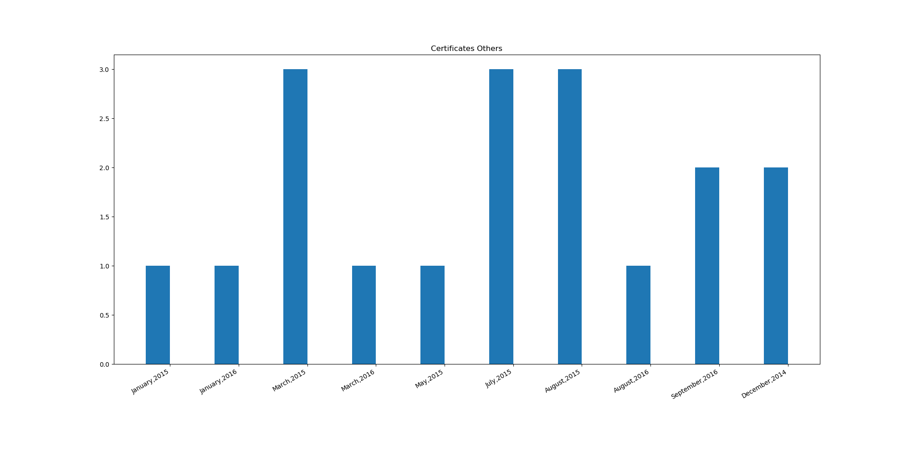
sdadas

Slide 12
sdadas

